Slide 1



Session 3
Working with ASP.NET Page
Models and Directives

Slide 2
Session Overview
Efexrpenlatinpadgief models
List and describe various Web Forms directives

Slide 3

Overview of Page Models
Inline Code/Single-File Page Model
(Classical Model)
Code-Behind Model

Slide 4
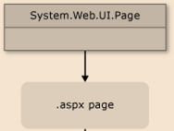
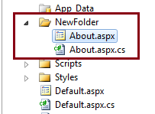
Differences Between Single-File Page/Code-behind Styles
Single-File Page
Code-behind
Markup and script handling for events embedded within
<script> tag are in same
.aspx file.
The .aspx file derives from the Page class.
When page is published, source code is retained along with the Web Forms page. Code cannot be viewed; only results are rendered when the page runs.
Only HTML and front-end controls of the Web page are in .aspx file. Class files supporting events generated from front-end are either in .aspx.vb or .aspx.cs file.
The .aspx file derives from a separate class in which the code for the page is compiled.
All project class files (without the .aspx file) are compiled into a .dll file, which is passed on to the server without any source code. On receiving a request for a page, an instance of the .dll file is created and executed.

Slide 5
Overview of Page Models
Inline Code/Single-File Page Model
Code-Behind Model

Slide 6
ASP.NET Web Forms Directives (1-11)
Different Types of Directives
Application Directive
(Defines a set of attributes specific to an application)
Syntax
<%@ Application
attribute="value"[
attribute = "value"] %>
Attributes Used by the Directive
Language, Inherits, Description, CodeBehind
Example
<%@ Application
Inherits="Program.object"
Description="New Program" %>

Slide 7
ASP.NET Web Forms Directives (2-11)
Control Directive
(Specifies the user specific controls used by the compiler and parser)
Syntax
<%@ Control attribute="value" [ attribute = "value" ] %>
ClassName, AutoEventWireup, Description, Inherits, Explicit, EnableViewState, Language, CodeFileBaseClass, Src, TargetSchema
<%@ Control Language="C#" EnableViewState="false" %>
Attributes Used by the Directive
Example

Slide 8
ASP.NET Web Forms Directives (3-11)
Assembly Directive
(Comes into the picture while linking a user control, Web pages, or an application file)
<%@ Assembly Name="assembly1" %>
Syntax
Src, Name
Attributes Used by the Directive
For Aptech Centre Use Only
Example
<%@ Assembly Name=AssemblyNew" %>
<%@ Assembly Src="Demo.cs" %>

Slide 9
ASP.NET Web Forms Directives (4-11)
Imports Directive
(Used to import the namespace to the Web page)
<%@ Import Namespace="value" %>
Syntax
Attributes Used by the Directive
Namespace
For Aptech Centre Use Only
Example
<%@ Import Namespace="System.Net" %>

Slide 10
ASP.NET Web Forms Directives (5-11)
Implements Directive
(Expresses that the user control, the page, or master page is applied in the specified .NET framework)
<%@ Implements interface
="interface_name" %>
Syntax
Attributes Used by the Directive
Interface
For Aptech Centre Use Only
Example
<%@ Implements Interface="ProgrammingASPNET. IDataAccess " %>

Slide 11
ASP.NET Web Forms Directives (6-11)
MasterType Directive
(Expresses that the user control, the page, or master page is applied in the specified .NET framework)
<%@ MasterType attribute="value" [ attribute = "value" ] %>
Syntax
Attributes Used by the Directive
TypeName, VirtualPath
For Aptech Centre Use Only
Example
<%@ MasterType VirtualPath="~/Templatesampl e.master " %>

Slide 12
ASP.NET Web Forms Directives (7-11)
Output Cache Directive
(Expresses that the user control, the page, or master page is applied in the specified .NET framework)
<%@ OutputCache Duration="Seconds" Shared="True | False" VarByControl = "controlname" VarByHeader="header" VarByParam = "parameter" CacheProfile="profile name" ProviderName="provider name" Location=" Client | Server | None ServerAndClient | Any "%>
Syntax
For Aptech Centre Use Only
Attributes Used by the Directive
Duration, VarByHeader, VarByParam, VarByCustom
Example
<%@ OutputCache Duration="50" VarByParam="None" %>

Slide 13
ASP.NET Web Forms Directives (8-11)
Master Directive
(Utilized to state the page file as master file)
<%@ MasterPage Language = "C#" AutoEventWireUp="true" CodeFile="SiteMaster.master.cs" Inherits="SiteMaster" %>
Syntax
ClassName, CodeFile, AutoEventWireup, Debug, EnableTheming, Description, Language, MasterPageFile
<%@ Master Language="C#" CodeFile="Master1.master.cs" Inherits="MasterPage" %>
Attributes Used by the Directive
For Aptech Centre Use Only
Example

Slide 14
ASP.NET Web Forms Directives (9-11)
Page Directive
(Explains the characteristics for a particular page for the compiler or parser)
<%@ Page attribute="value" [ attribute="value" …. ] %>
Syntax
For Aptech Centre Use Only
<%@Page Language="C#" EnableViewState="True" Description="Web Page" %>
Example

Slide 15
ASP.NET Web Forms Directives (10-11)
Reference Directive
(Used for pointing another page or control that is compiled to the current page)
Syntax
<%@ Reference Page="Default.aspx" %>
Attributes Used by the Directive
Page, VirtualPath, Control
For Aptech Centre Use Only
<%@ Reference Control="MyEmployeeControl.aspx" %>
Example

Slide 16
ASP.NET Web Forms Directives (11-11)
Register Directive
(Used for defining the custom control to the tag prefix developed by the user)
Syntax
<%@ Register tagprefix="tag1" namespace="namespace" assembly="assembly" %>
<%@ Register tagprefix="tag2" tagname="tagname" src="pathname" %>
For Aptech Centre Use Only
Attributes Used by the Directive
Assembly, Src, TagName, TagPrefix
<%@ register tagprefix="uc1" tagname = "EmployeeUserControl" src="~/EmployeeUserControl.ascx" %>
Example

Slide 17
ASP.NET @Page Directive (1-4)
ASP.NET @Page Directive refers to page-specific attributes used by the ASP.NET page parser and compiler, which are included only in .aspx files.
For Aptech Centre Use Only
Points to note when using the @Page directive
i@rPecatgivee cdan be utilized specifically in Web Forms
Only one @Page directive can be included per .aspx file
Only one language attribute can be defined per @Page directive

Slide 18
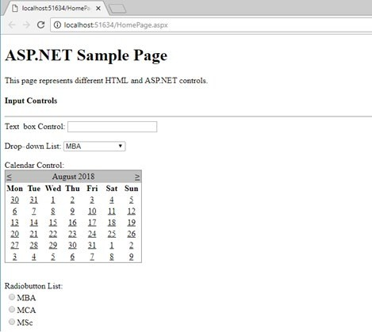
ASP.NET @Page Directive (4-4)
For Aptech Centre Use Only
ASP.NET Sample Web Page with ASP.NET Controls

Slide 19
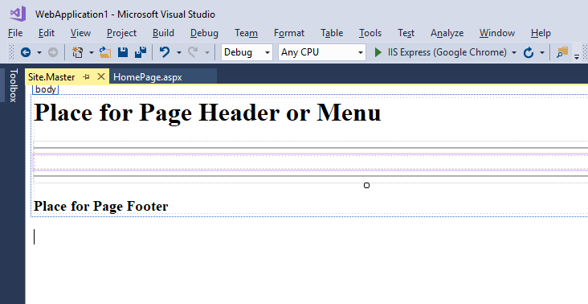
ASP.NET Master Page (1-3)
Delivers a template, to apply a consistent appearance and behavior for pages or group of pages in the Web application.
Specifies placeholders for the content, which can be superseded by individual pages.
Also, supports dynamic content.
For Aptech Centre Use Only
Master Page Design View

Slide 20
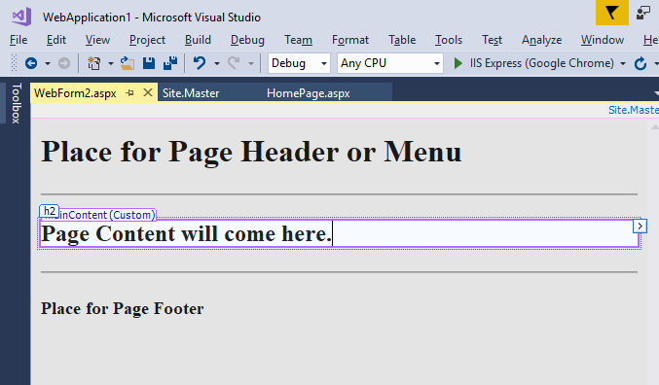
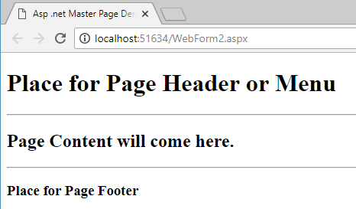
ASP.NET Master Page (3-3)
Content Page Design View
For Aptech Centre Use Only
Content Page Output with Master Page

Slide 21
Global.asax
Used to declare application-level events and objects
Automatically generated, when a new Web project is created Must stay in the IIS virtual root
Events and state indicated in the global file are further applied to all resources allocated within the Web application
Compiled upon the arrival of the initial request for any resource in the application
For Aptech Centre Use Only

Slide 22
Application Directives
Positioned at the top of the Global.asax file
Provide information that is used to compile the global file.
There are three application directives defined, namely:
For Aptech Centre Use Only
Application
Assembly
Import

Slide 23
Summary
ASP.NET supports two coding styles, Single-page model and Code-behind model.
In a single-file page model, a mark-up of a Web Form page as well as its programming code are in the same .aspx file whereas in the code-behind model they are in different files.
ASP.NET directives are guidelines for indicating optional settings such as registering a page language and custom control.
In general, each ASP.NET page begins with the @ Page directive and can be used only in Web Forms.
Master pages are used for creating a consistent look and behavior for all pages or a group of pages in the Web application.
For Aptech Centre Use Only

